Slide 1
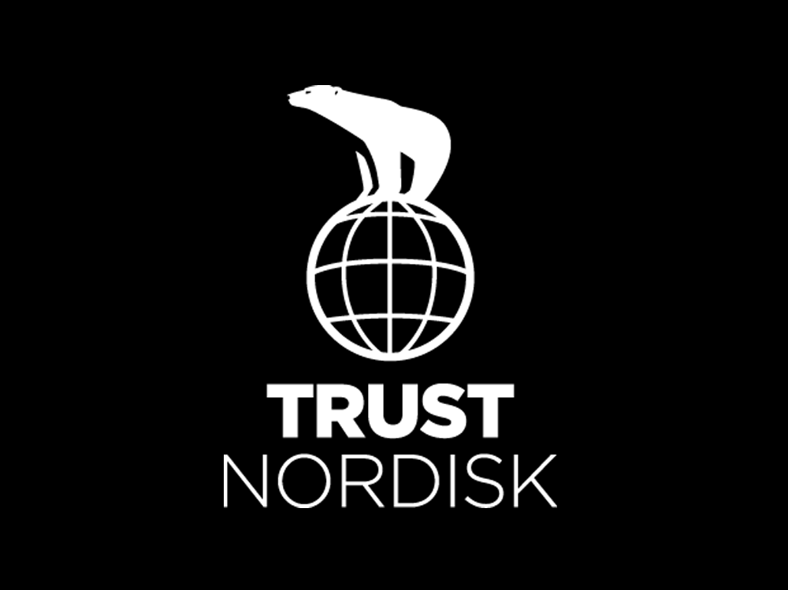

Slide 2
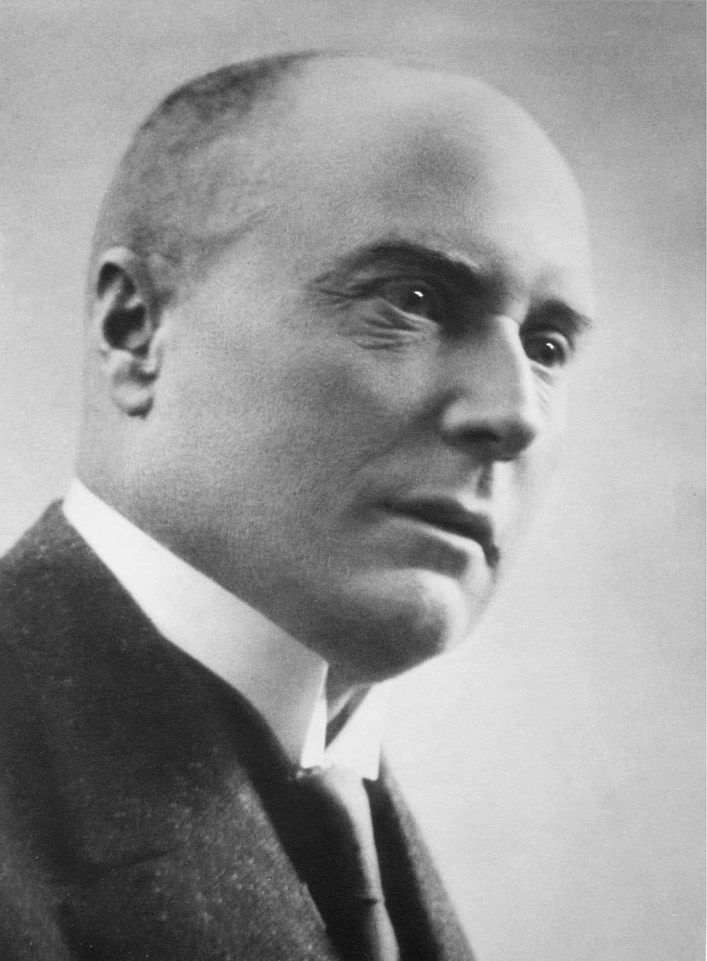


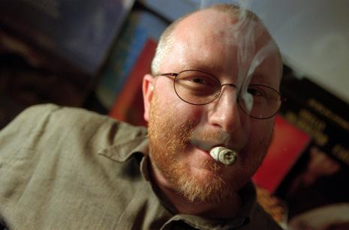

TrustNordisk is the result of the 2008 merger between Trust Film Sales and Nordisk Film International Sales.
Trust being the sales arm of Zentropa owned by Peter Ålbæk and Lars von Trier and
Nordisk being the oldest Production company in the world. Founded in 1906
Not easy to combine the old tradional company with the Polar bear and the quer and untraditional man with the cigar.

Slide 3


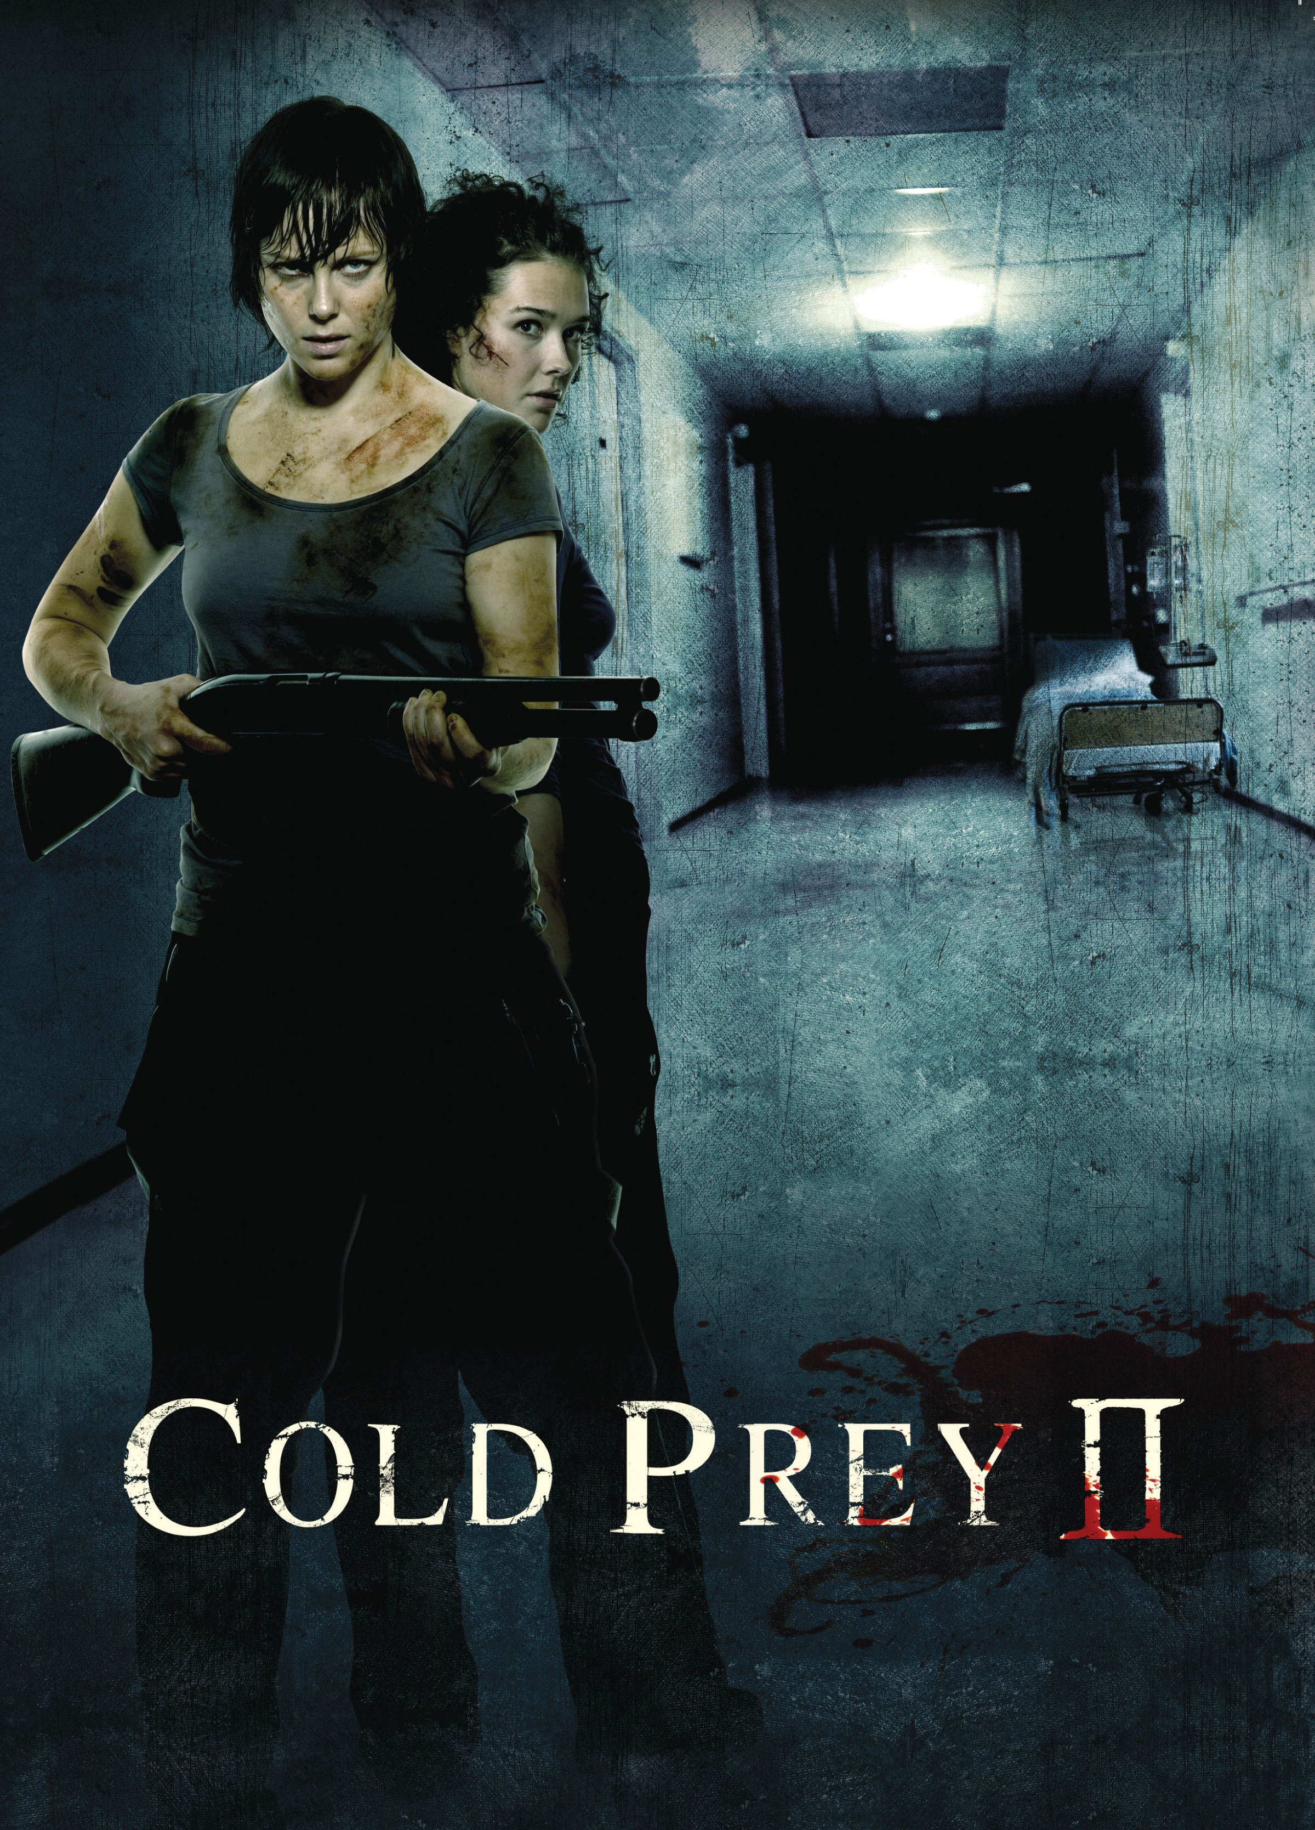
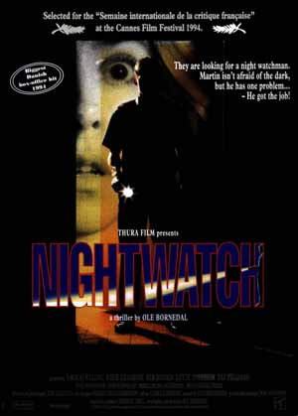
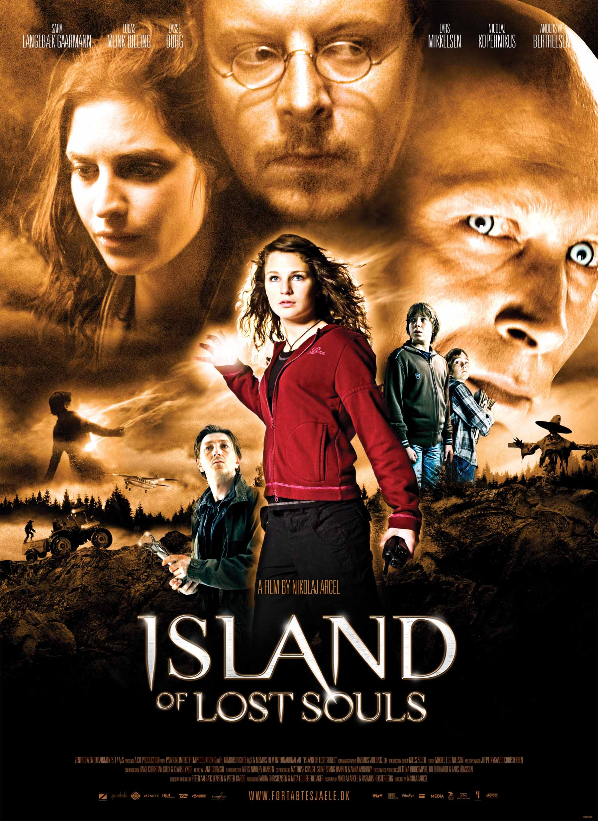
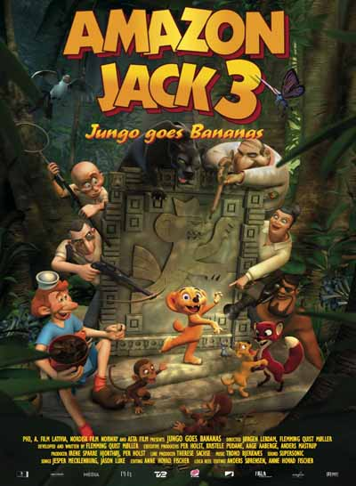
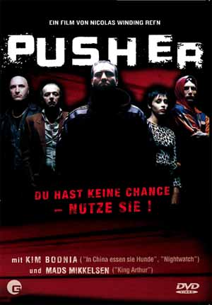
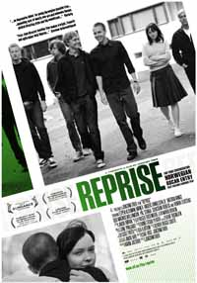
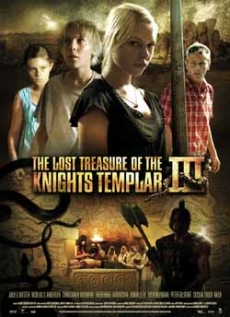

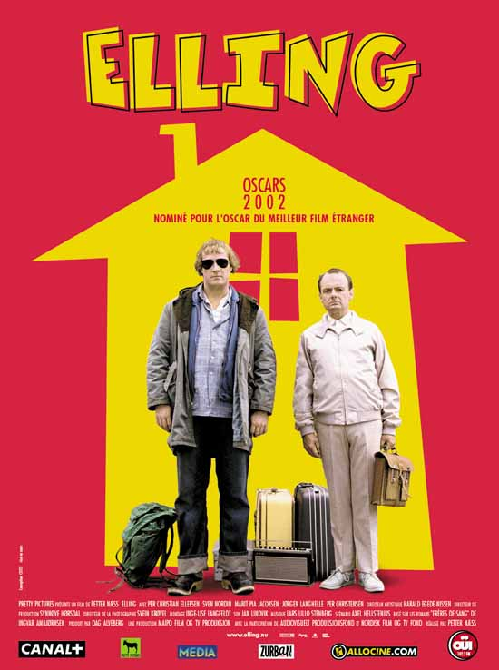
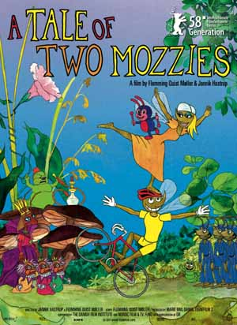
ARTHOUSE
MAINSTREAM
FAMILY
ARTHOUSE: Acclaimed Directors and/or selected for Major Festivals.
MAINSTREAM: Genre titles (thriller, horror, crime) , Drama, Comedy
FAMILY: Children Films, Animation, Adventure, Children Series

Slide 4
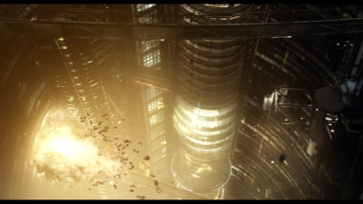
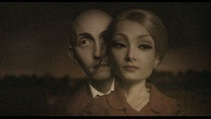
Metropia directed by Tarik Saleh
Back ground within documentaries (Gitmo, Sacrifico – Who betrayed Che Guevara
Co founder of Atmo Animation.
Metropia is developed together with Martin Hultman

Slide 5
Metropia directed by Tarik Saleh
Back ground within documentaries (Gitmo, Sacrifico – Who betrayed Che Guevara
Co founder of Atmo Animation.
Metropia is developed together with Martin Hultman

Slide 6
Metropia
Facts
Genre: Scifi Thriller Animation
Budget: € 3,5 million
Target group: 15 years and up. More male orienated

Slide 7
Metropia
The Story
METROPIA takes place in a not-so-distant future.
The world is running out of oil and the underground train Systems have been connected into a gigantic subway network beneath Europe.
Through this system the Government is able to manipulate with peoples minds and Roger sets out to stop this conspiracy

Slide 8
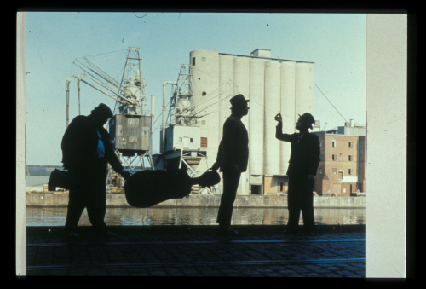
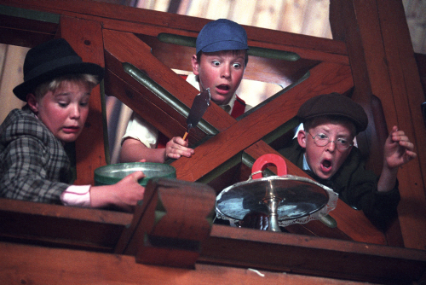
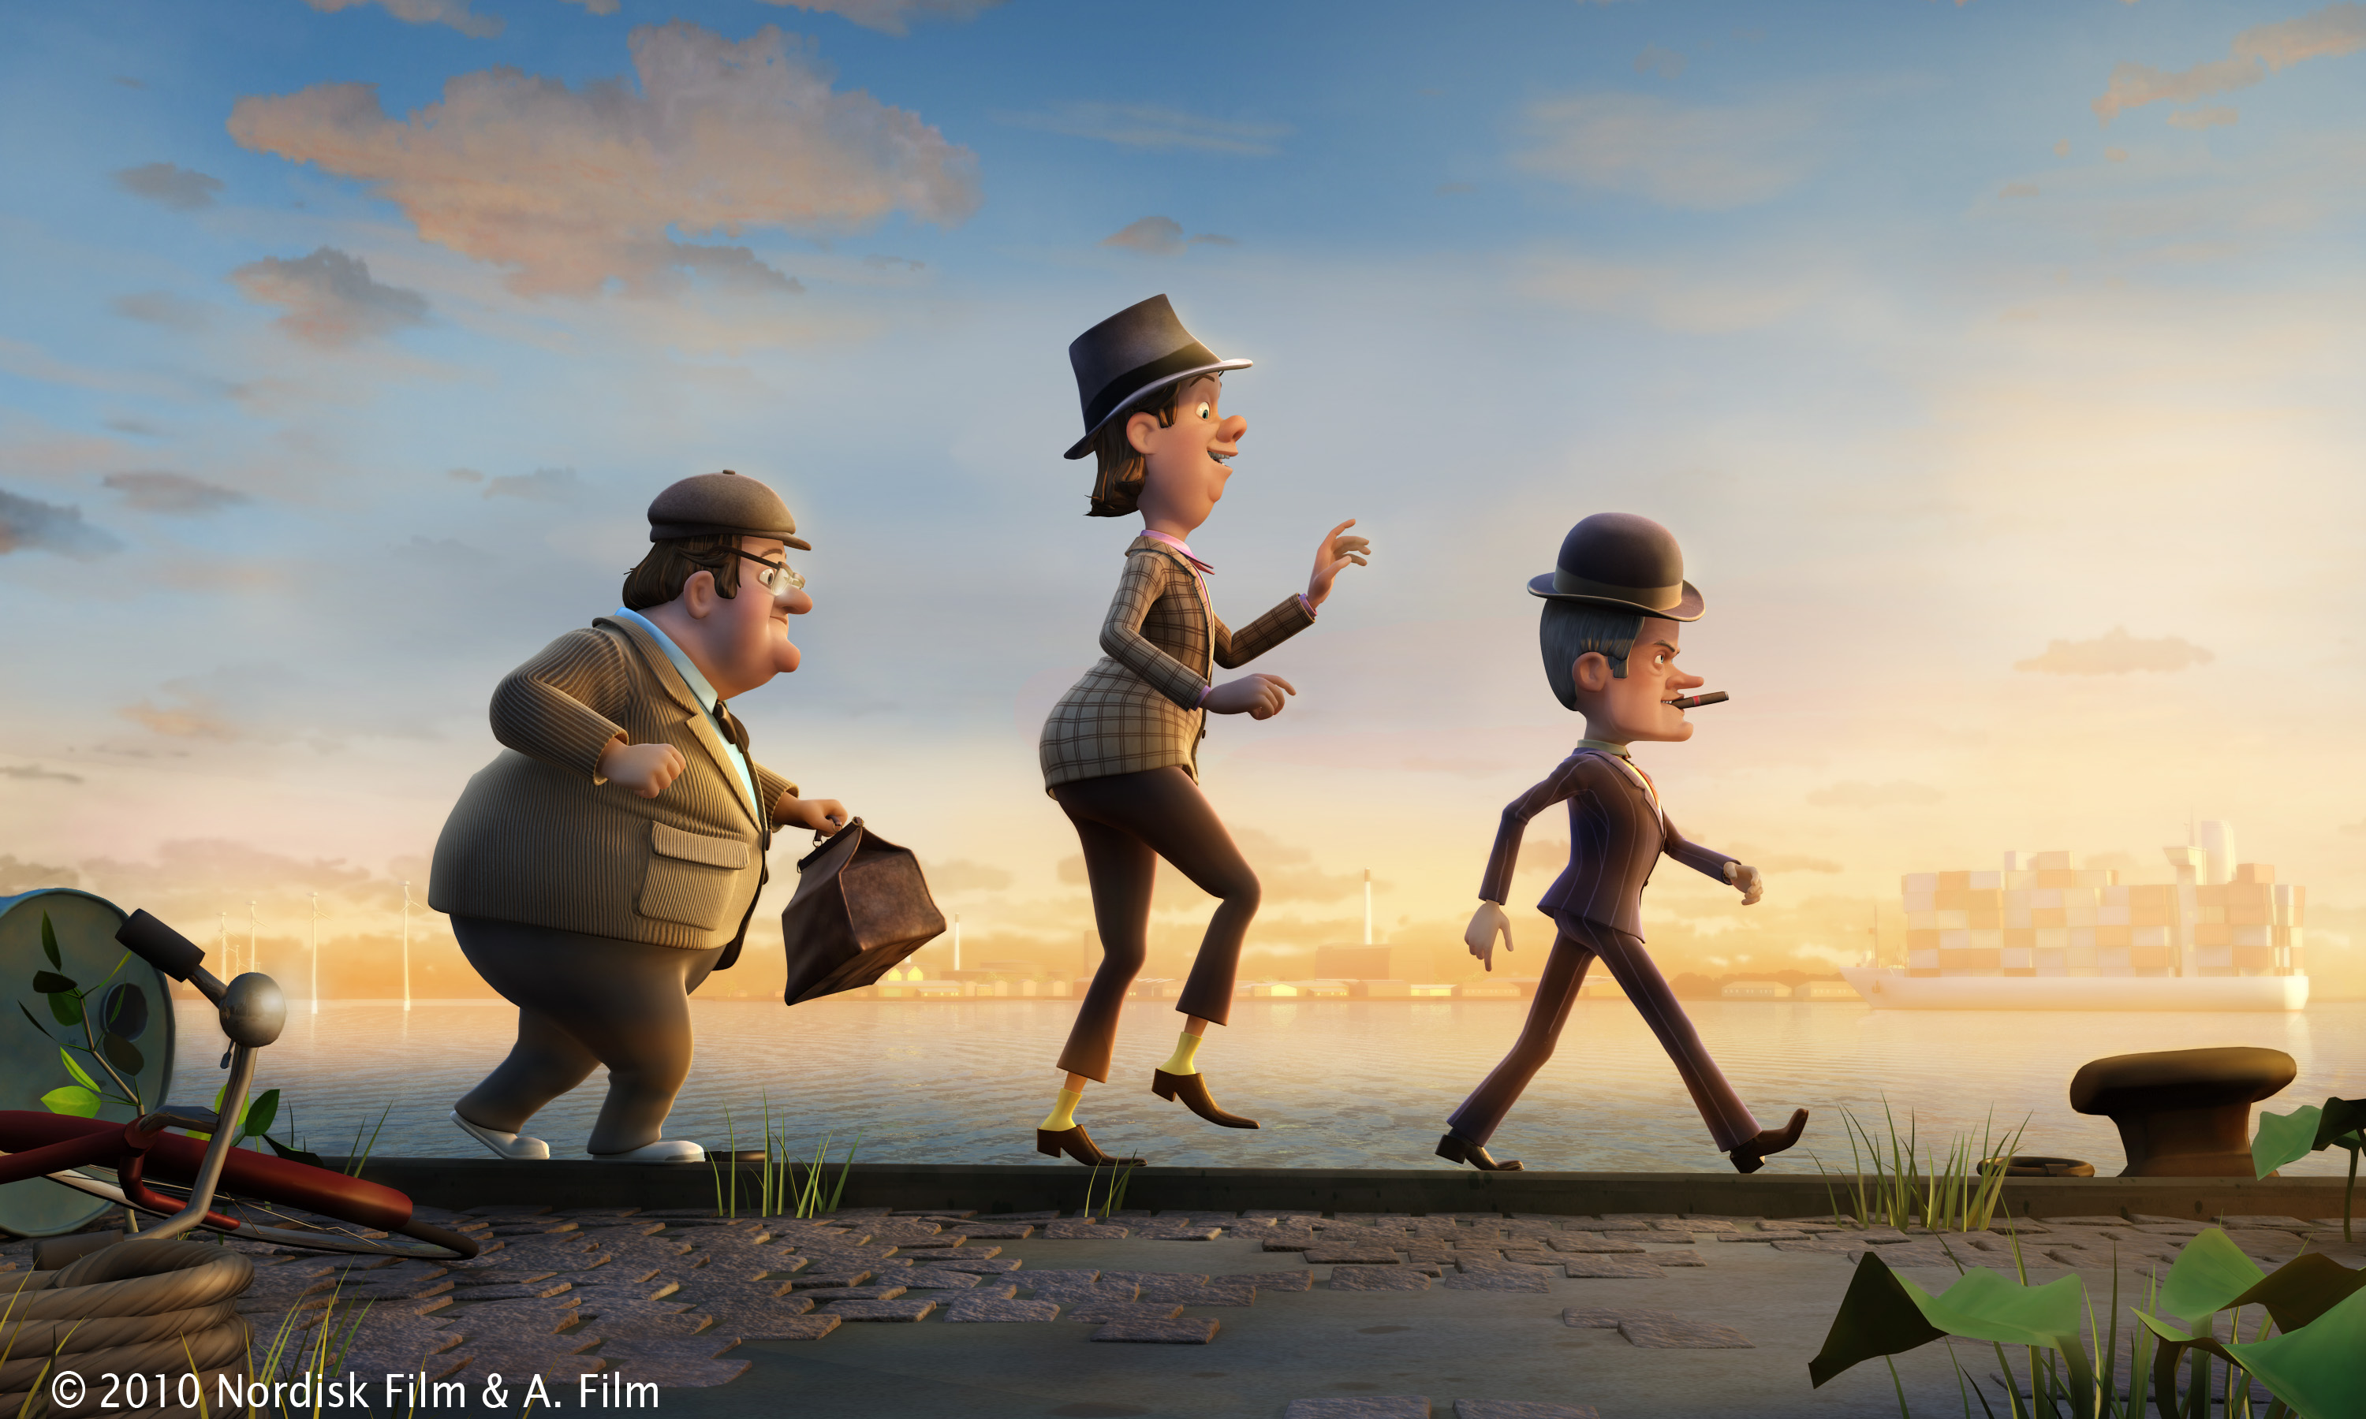
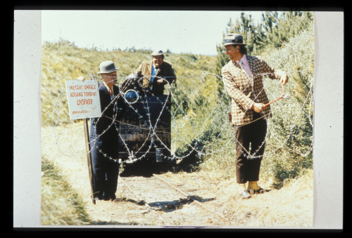
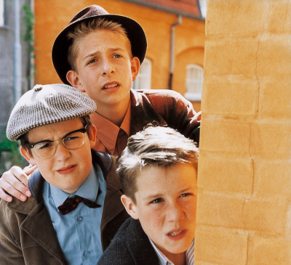
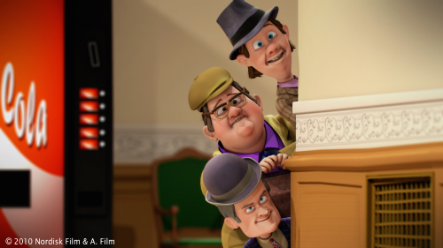
Old Classics in New Suroundings
The Olsen Gang is a classic in Scandinavia in the 60’ies and 70’ies. Later they were made as family titles and now the first Stereoscopic 3D animation is on its way.

Slide 9
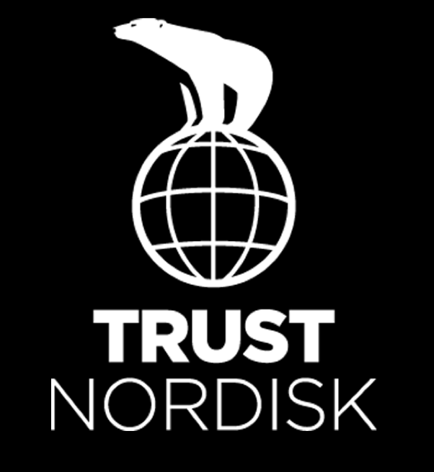
www.trustnordisk.com

